Slide 1
HUUSD
FY2018 July 1, 2017 to June 30, 2018-Budget Presentation #1
November 9, 2016

Slide 2
FY2018 Budget Development Preliminary Schedule
November 9, 2016 – Student enrollment trends, Current staffing, School programs and Grade configurations
November 30, 2016- Projected budget expenditures, with additional information on Staffing and Technology expenses
December 7, 2016-Continued discussion on budget expenditures with a focus on Operations and Maintenance & Food Service Programs
December 14, 2016-First presentation of estimated F2018 Revenues along with continued discussion of budget expenditures
December 21, 2016 (Reserved in case of weather cancellation)
January 11, 2017-Continued budget discussions with anticipated statewide data on equalized pupils, education tax rates and other factors
January 25, 2017 - Final meeting to discuss, adopt and warn budget to be voted on March 2017 Town Meeting Day

Slide 3
Topics to be covered in tonight’s presentation
Enrollment Trends – Enrollment in all schools grades PK through 12 including enrollment & class size projections for 2017-2018
School Staffing and Programs, including teachers, support staff and administration
Basic demographic information for each school
Overall FY2017 Combined Budgets
Average Salary and Employee Benefit information
The goal of tonight’s presentation is to provide a base level of information on each school as a foundation for future budget discussion

Slide 4
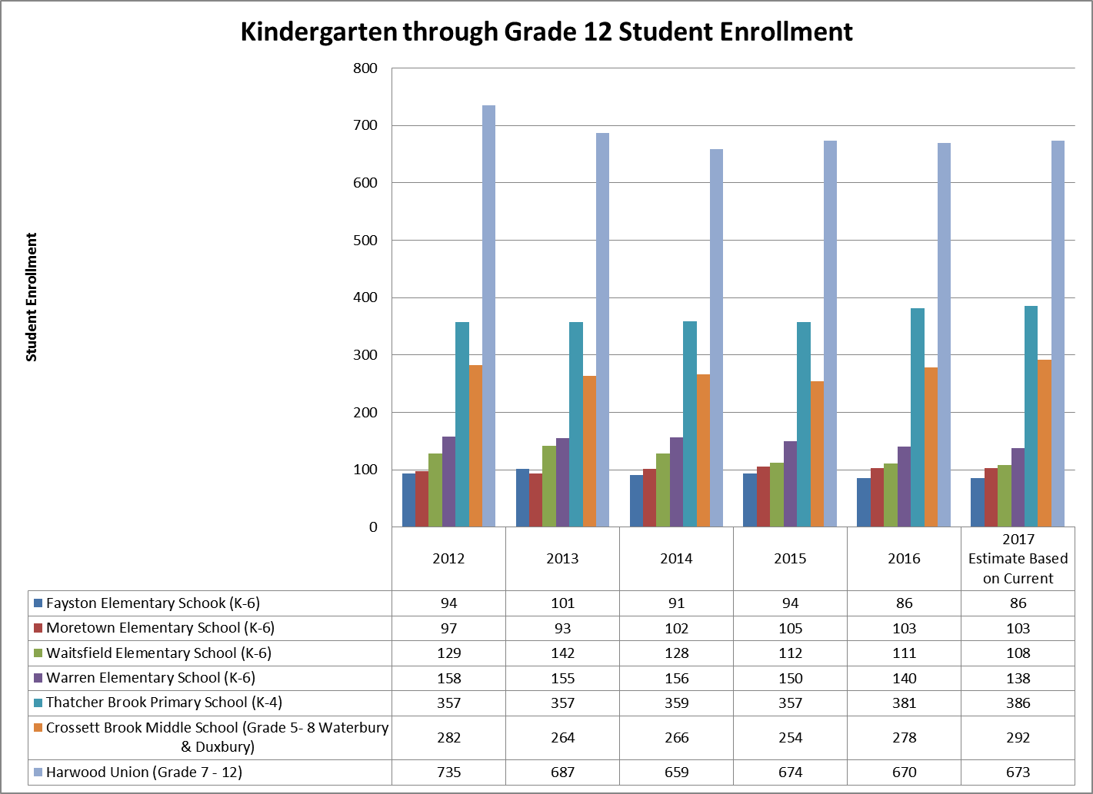
Enrollment Trends – See Handout for Details
Notes:
All Students – Includes Tuition – See Handout and Review Enrollment by Grade for each school 20019 to present

Slide 5
Pre-Kindergarten Enrollment (Includes those enrolled in private pre K programs with funding from district schools)
Notes:
Will be covering specific information regarding Pre-K programs offered by each elementary school a bit later

Slide 6
Tuition Student Enrollment for students coming into SU Schools from Outside the SU (Kindergarten-Grade12)
Notes:
Will be talking about providing bus from Granville and Hancock to Warren, Waitsfield and HU

Slide 7
From Student Enrollment to Staff FTE (Full time equivalents)
Details of Current Staffing at each school and the SU, including student/staff ratios – see handouts.

Slide 8
Summary Demographics-See Handout for Details

Slide 9
Summary Staff FTE’s-See Handout for Details

Slide 10
Estimated Class sizes K-8 in 2017-18
Notes:
Superintendent Discussion, mention HU Program of Studies for Gr 7-12 HU Course Offerings

Slide 11
Pre-Kindergarten Programs
Act 166 provides pre-Kindergarten choice. This year 3 and 4 year old students from WWSU towns attend 15 pre-kindergarten programs other than the 5 programs offered by our schools.
Warren and Moretown pre-kindergarten programs have taken in 11 students from outside WWSU as noted on the tuition slide.
See Handout providing additional information on WWSU current Pre-K programs.

Slide 12
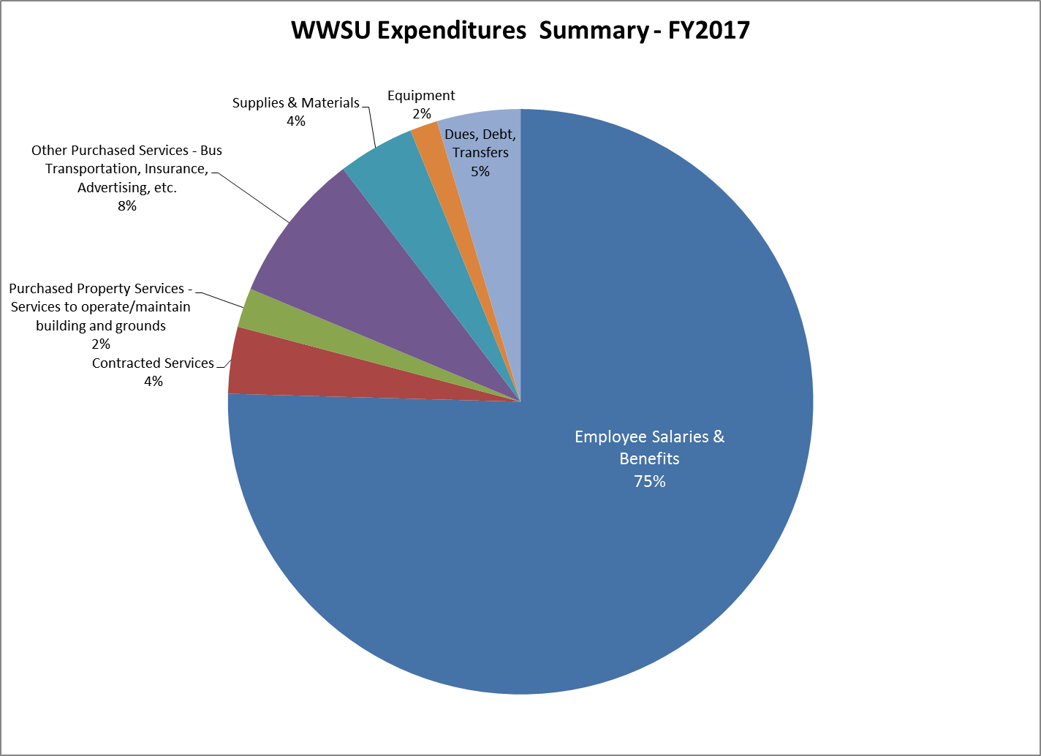
Summary Budget Expenditures-FY2017

Slide 13
Summary of Total Expenditures HUUSD
Notes:
Average 2017 Teacher Salary - $60,600
WWSU general assessment represents 4% of overall expenditure budget

Slide 14
What are the Employee Benefits making up 19% of the expenditures
Health Insurance
Dental Insurance
Life Insurance
Long Term Disability Insurance
Professional Development
Worker’s Compensation
VT Unemployment Insurance
FICA/MCare

Slide 15
Discussion & Questions
Notes:
Brigid Nease will Lead this, We can discuss PK in detail or adding the Hancock and Granville bus

